Slide 1




An ISO 21001:2018 certified institution | S. S. Education Trust’s CET Code: E-175 (UG)/T-942 (PG) S. G. BALEKUNDRI INSTITUTE OF TECHNOLOGY Shivabasavanagar, Belagavi- 590 010, Karnataka- India • Approved by AICTE New Delhi • Recognised by Govt. of Karnataka • Affiliated to V T U, Belagavi
 | Department of Computer Science Engineering Email: hod-ec@sgbit.edu.in, Dept. Extn.: 520 | Accredited by NBA, New Delhi
Project Phase – 2 Presentation
On
“Mental Health Assistance based on Emotion Recognition using Machine Learning”
Group No. 3 | Name of the Student | University Seat Number
 | Ms. Madhushri Wadki | 2BU19CS015
 | Mr. Shikhar Shetty | 2BU19CS040
 | Ms. Smita Patted | 2BU19CS043
 | Mr. Tejas Biradar | 2BU19CS051
 | Under the Guidance of Ms. Rajeshwari Kisan Assistant Professor, Dept. of CSE S. G. Balekundri Institute of Technology, Belagavi-10

Slide 2
Contents
Introduction
Literature Review
Problem Statement
Objectives
Requirements Specification
Proposed Architecture Diagram
Workflow Diagram
Use-case Diagram
References

Slide 3
Introduction
People tend to express their emotions, mainly by their facial expressions. Music and videos have always been known to alter the mood of an individual.
The project aims to capture the emotion expressed by a person through facial expressions.
A music player is designed to capture human emotion through the web camera interface available on computing systems.
The software captures the image of the user and then with the help of image segmentation and image processing techniques extracts features from the face of a target human being and tries to detect the emotion that the person is trying to express.

Slide 4
Literature Review
S.No | Authors | Title of Paper | Methodology | Limitations
01 | Shashwati Tidke, Ganesh Bhutkar, Dnyanal Shelke, Shivani Takale & Shraddha Sadke | Mood-Based Song Recommendation System | Detects the human face from the captured image. According to positions of the located facial key-points, SVM(Support Vector Machine) classifiers detect the emotion. The system uses the detected emotion for song filtration. | System user do not get access to a large number of songs. The dataset for this system consists of Bollywood songs only.
02 | Manoj Sabnis, Bhavesh Bhatia, Laveena Punjabi, Navin Rohra | Music Recommendation through Face Recognition and Emotion Detection | CNN-based model detects the emotion and proposes a music playlist according to the mood of the user. | Accuracy level can be increased.
03 | Adarsh Kumar Singh, Rajsonal Kaur & Devraj Sahu | Real-Time Emotion Detection and Song Recommendation Using CNN Architecture | The model extracted features from the input images and the facial emotion was recognized. The system therefore recommends songs based on the facial expression detected. | The resolution of images used as low-quality could not be properly detected.

Slide 5
Problem Statement
To create a system that can accurately detect the emotional state of a user based on their input, such as image and recommend music and videos that are most likely to resonate with their current emotional state.
The goal is to enhance the user's experience by providing personalized recommendations that can uplift their mood or help them manage their emotions.
The success of this system will be measured by how accurately it can detect the user's emotional state and how effective the recommended content is in positively impacting the user's mood or emotions

Slide 6
Objectives
Train a Deep Learning model for facial expression or emotion recognition based on the user’s facial feature extraction from the emotion dataset fed to train the model.
Test the trained model for detection of facial expressions and emotions.
To develop a music and video recommendation system which will recommend music and videos depending on the mood of the person which is determined by the facial expression.
To develop a web app which can be used to capture the image of the person to determine the facial expression and hence the mood and then suggest the proper videos and music to cheer the persons mood.

Slide 7
Requirements Specification
Software Requirements
Python – 3.9 or above
Flask
OpenCV
Sklearn
Vscode IDE
Hardware Requirements
Corei5 Processor with minimum 4GB of RAM
Web Camera with minimum 720 P resolution

Slide 8
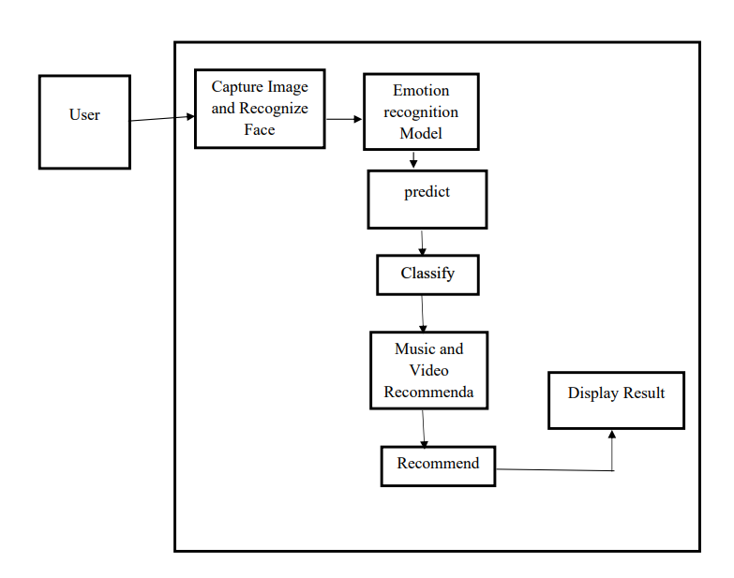
Proposed Architecture

Slide 9
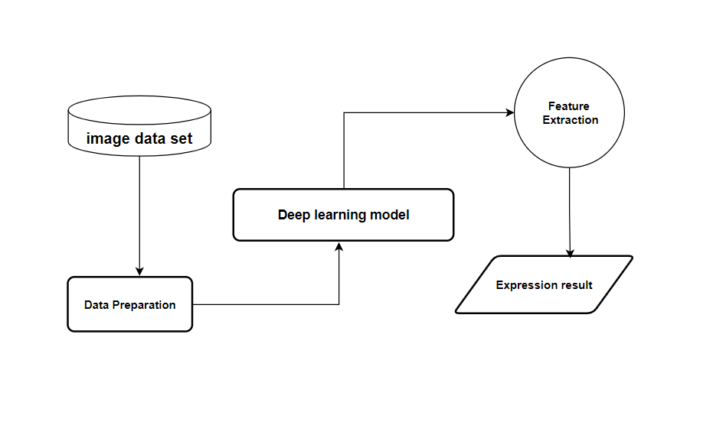
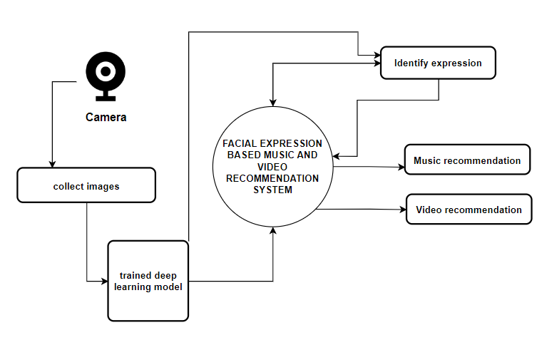
Workflow Diagrams
DFD 0
DFD 1

Slide 10
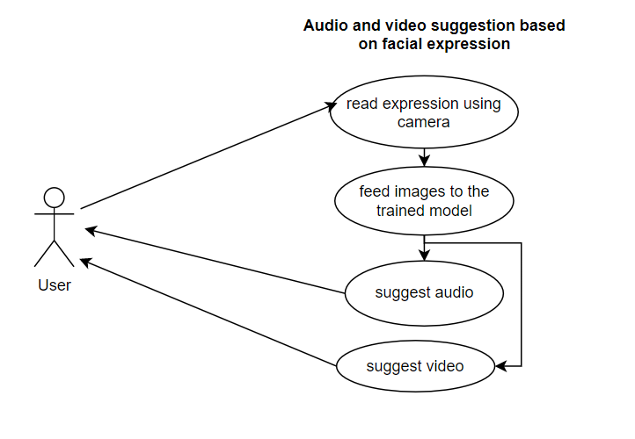
Use-Case Diagram

Slide 11
References
Shashwati Tidke, Ganesh Bhutkar, Dnyanal Shelke, Shivani Takale & Shraddha Sadke, “Mood-Based Song Recommendation System”, 2022 https://link-springercom.vtutest.mapmyaccess.com/chapter/10.1007/978-3-031-02904-2_9
Manoj Sabnis, Bhavesh Bhatia, Laveena Punjabi, Navin Rohra ,“Music recommendation through face recognition and emotion detection” 2022 https://www.irjet.net/archives/V9/i3/IRJET-V9I3370.pdf
Adarsh Kumar Singh, Rajsonal Kaur & Devraj Sahu, “Real-Time Emotion Detection and Song Recommendation Using CNN Architecture”, 2021 https://link-springercom.vtutest.mapmyaccess.com/chapter/10.1007/978-981-33-4859-2_37
Ziyang Yu, Mengda Zhao, Yilin Wu, Peizhuo Liu, Hexu Chen, “Automatic Music Recommendation Based on Facial Micro-expression Recognition”, 2020 https://doi.org/10.23919/CCC50068.2020.9189600

Slide 12
Thank you

